Slide 1
Playing With Words
Harshit Sharma, Krishna Agarwal, Palak Gupta, Pooja
GLA University
Department of Computer Engineering and Applications
4/12/2023

Slide 2
Introduction
The primary aim of this project is to enhance users' verbal skills and expand their vocabulary through engaging and creative activities.
The motivation behind this project is to develop a platform to improve users' certain verbal skills
This can be useful to the students and anyone who wants to gear up their verbal skills and expand their vocabulary.

Slide 3
Objectives
This project tends to target the audience which requires the platforms to improve their certain verbal skills like vocabulary, pronunciation, testing typing speed and much more in a playful and interesting environment. We try our best to not just make the activities innovative and appealing but also productive and knowledgeable.

Slide 4
Problem Statement
There are many people which tackle the obstacles like wrong pronunciations, repetitive vocabularies, knowing diminished meanings of words, lessen typing speeds for coders.
These problems when addressed, they rather leave the user embarrassed or hesitant.

Slide 5
Literature Review
Thus, our aim is to individually address each problem through pleasing activities on a combined platform, i.e. one platform provides various features to practice for such obstacles and find win over them. We provide fun tasks and games like typing speed analyzer, text analyzer, text to speech etc. to help the user in every we can.

Slide 6
Methodology
Use of languages like HTML, CSS, JavaScript, node.js,Mongo DB, EJS
Tools used are Visual Studio Code (Version 1.78.2).

Slide 7
Implementation
Plan to be implemented as follows:
Dictionary : 30-31 October 2023
Text Analyzer : 1-2 November 2023
Text To Speech : 3-4 November 2023
Speed Test: 5-7 November 2023
Typing Champion: 7-8 November 2023

Slide 8
Implementation
White Board: 9-11 November 2023
Scramble: 12-13 November 2023
Sample Mid Term Report: 14 November 2023
Final Mid Term Report: 15 November 2023
Integration of every single feature onto a single platform: 16-22 November 2023

Slide 9
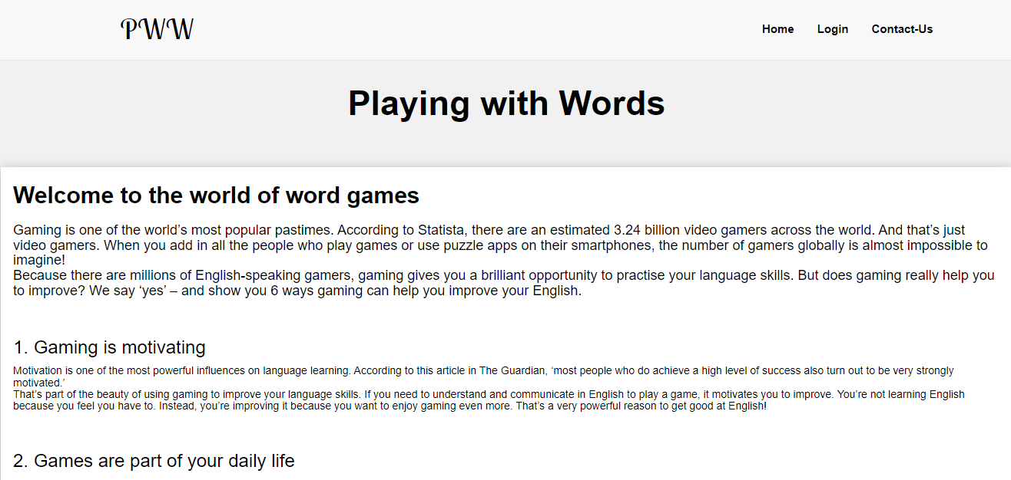
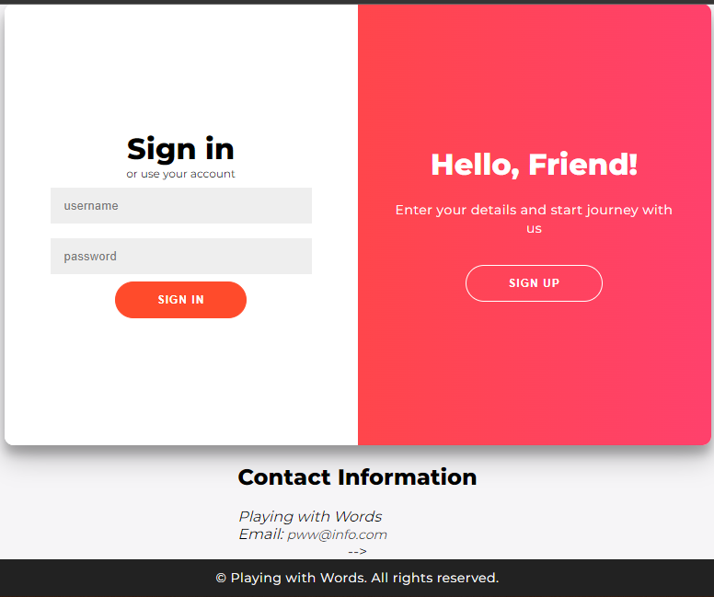
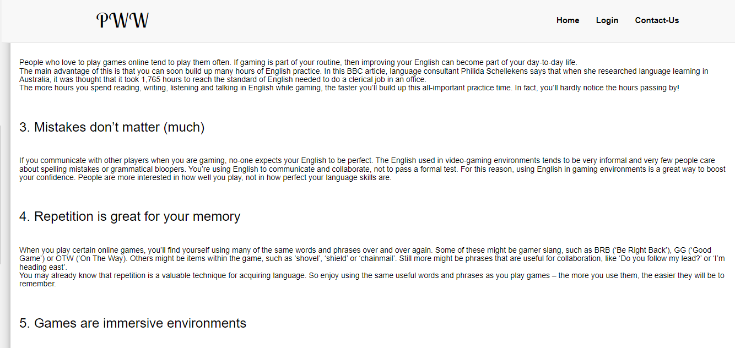
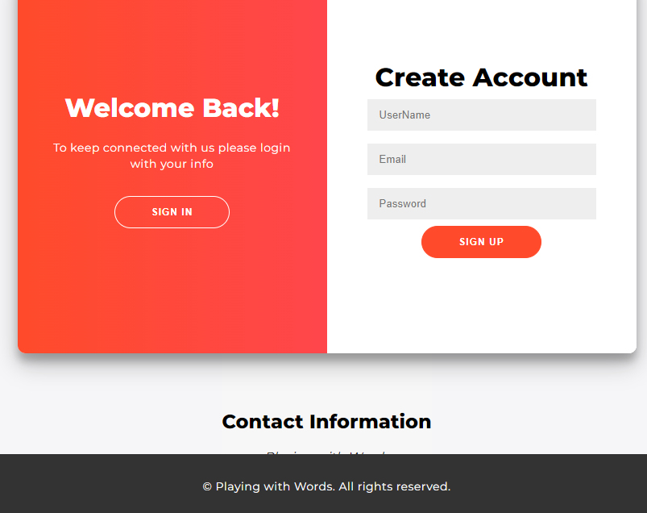

Slide 10
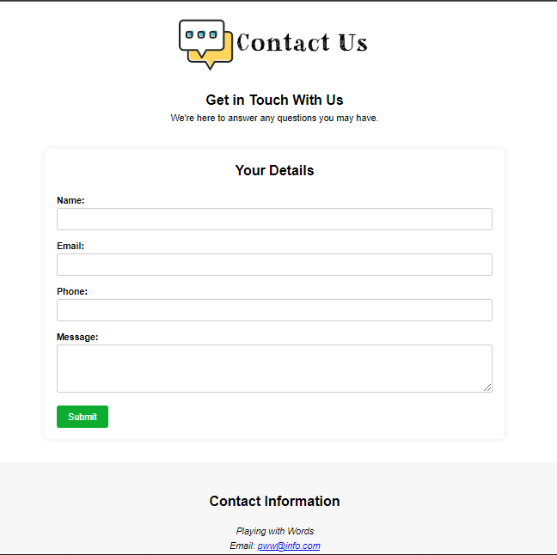
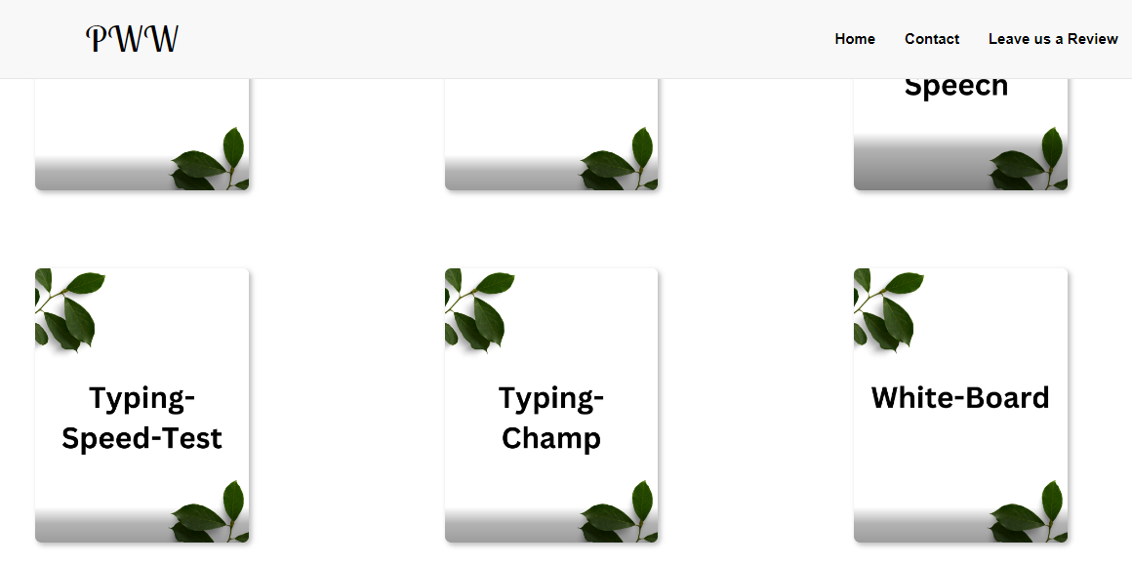
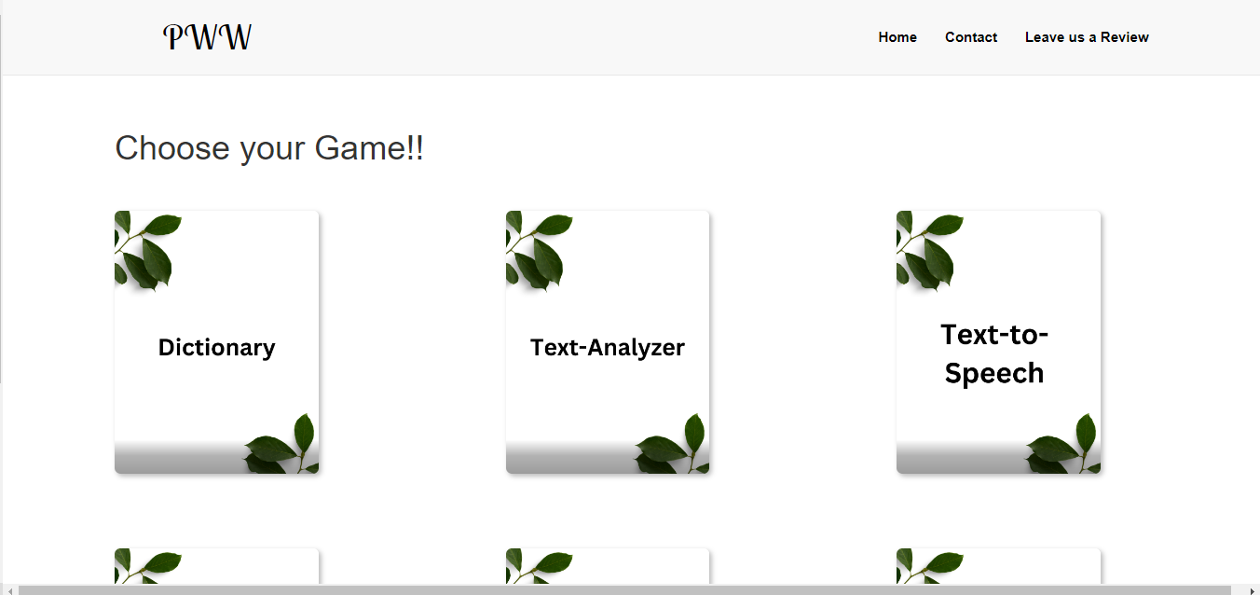

Slide 11
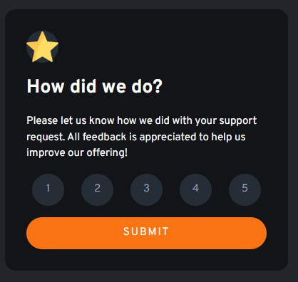
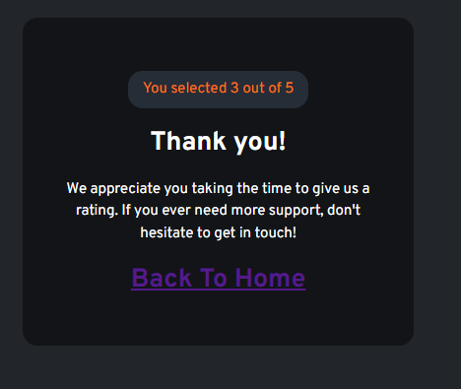

Slide 12
Features
User Friendly
Providing enthralling experience
Expanding the range of lexis
Availability of attribute to keep notes in the form of text and images
Real time and accurate information

Slide 13
Results
After an appropriate session time on the platform the user is expected to have a better understanding of pronunciation, vocabulary, spelling and achievement of improved typing speed.

Slide 14
Challenges Faced
We faced difficulties in putting the features and make the website look good and major and the important issue was to make the website responsive.
We took the help from the internet and friends. After some valuable efforts we overcame the challenges.

Slide 15
Future Work
We will add some more games to this website and will make it useful to as more as learners want to learn something new and they can go one step up in their lives.

Slide 16
Conclusion
The website could be operated by the user belonging to any age group by indulging in various engaging activities for the betterment of their certain verbal skills while having fun at the same time.

Slide 17

Q&A
Open the floor for questions from the audience

